Slide 1

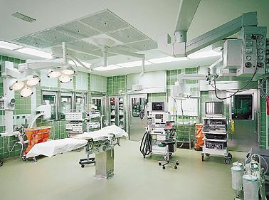

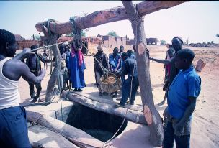
Project Management
Dominique Jaccard

Slide 2
Table of contents
Overview
Project Initiation
Project Planning
Project Execution
5
20
37
53

Slide 3
Program
Day 1: 9h15 - 18h30
Project management overview
Project initiation
  Theory
  Practice: Project Management Simulation
Day 2: 9h15 – 18h30
Project planning
  Theory
  Practice: Project Management Simulation
Day 3: 9h15 – 17h30
Project execution and closure
  Theory
  Practice: Project Management Simulation
Synthesis

Slide 4
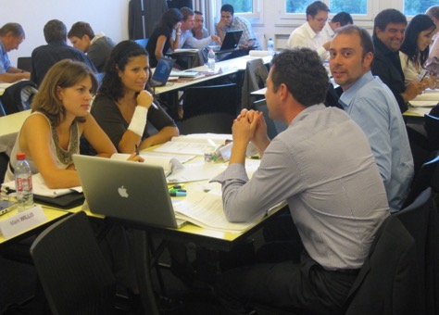
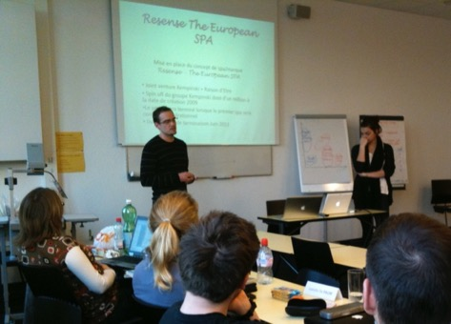
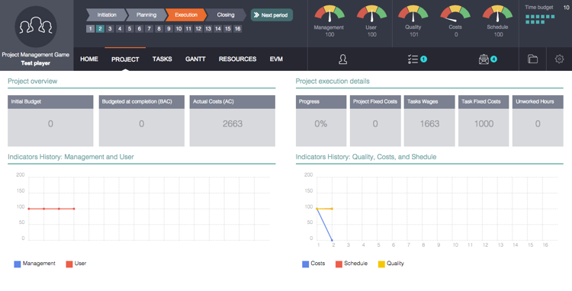
Project Management Simulation : www.albasim.ch
Teamwork
Role plays
Software

Slide 5
Overview
1

Slide 6

Introduction
Management & organization
  Hierarchy
  Communication
  Conflict management
  …
Tools and techniques
  Pert
  Gantt
  Risk management
  …
Soft skills
Hard skills

Slide 7
Definitions
Project
  A sequence of unique, complex and connected activities, having one goal and that must be completed by a specific time, within budget and according to specifications.
  [Wysocki]
Project management
  Application of knowledge, skills, tools and techniques to project activities to meet project requirements.
  [PMBOK]

Slide 8
Project Management Triangle
Scope
(Objectives, Specifications)
PROJECT
Cost
Time

Slide 9
Driven by ?
Quality
Costs
Schedule

Slide 10
Project phases
Initiation
Planning
Execution
Closure
Monitor & Control

Slide 11
Initiation
What objectives ?
Include:
  define goals and scope
  estimate resources, costs and schedule
  estimate risks
  identify benefits
  define project organization
Notes:
Relevance: doing the rigth thing

Slide 12
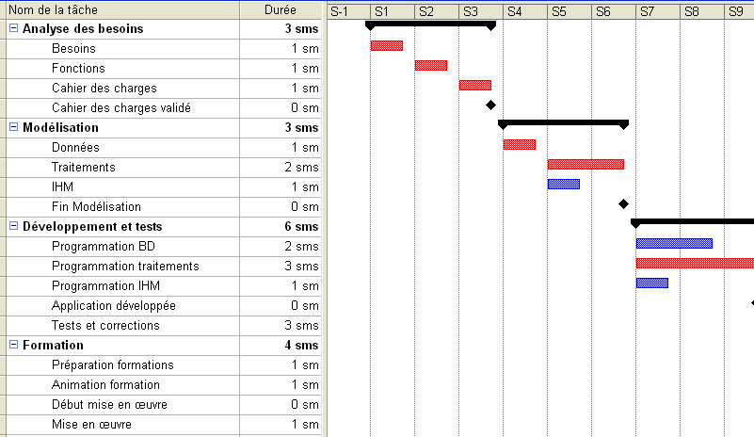
Planning
Plan the Execution ...
Include:
  tasks identification
  global planning
  detailed costs and schedule
  hire (key) resources
  define organization
Notes:
Efficiency: doing the thing rigth

Slide 13
Execution
Execute the Planning…
Include:
  executing the work
  monitoring cost, schedule, quality
  controling when needed
  managing changes
  solving problems…
source : pixabay

Slide 14

Closure
Improve future projects ...
Include:
  analyze results, compare with planning
  evaluate project execution
  identify lessons learned
  share lessons learned
source : www.sxc.hu
Notes:
Rem: longs projets
archivage à mesure

Slide 15
In practice ?

Slide 16
Waterfall model
Principles
  sequencial design
  progress flow steadily through Initiation, Planning, Execution
    analysis, design, production, testing, implementation
  precise deliverable for each phase
  gated-step approach
Advantages, disadvantages ?
Notes:
Avantages, inconvénients:
+ définition claire des tâches et livrable
+ approche incrémentale, cliquet
- obligation de définir la totalité du projet dès le début
- difficulté à gérer les changements
-réalité est rarement séquentielle

Slide 17
Iterative model
Principles
  repeated cycle (iteration)
  learned from precedent iterations
  adapt design, functionnalities
Advantages, disadvantages ?
Notes:
Avantages-Inconvénients
+ pas de bloquage sur une étape, les difficultés peuvent être levées dans une prochaine itération
+ permet de gérer plus facilement le changement
+ intégration de l’utilisateur
+ validation précoces
- augmentation perpétuelle des besoins
- remise en cause du travail des cycles précédents
- itérations sans fin
- mise en exploitation d’un résultat partiel

Slide 18
Intiation and planning
Consequences if neglected
Why neglected ?

Slide 19
Execution
Weakpoints ?
  Not interesting at monitoring the project
  Refuse to see reality
  Refuse to listen those who see problems

Slide 20
Project Closing
Consequences if neglected ?
Why neglected ?

Slide 21
Project initiation
2
21
Notes:
After this overview, we'll now analyze more deeply project initiation

Slide 22

2.1
From ideas to objectives
source : www.sxc.hu
Notes:
how to move from ideas to objectves, how to transform ideas in objectives

Slide 23

Define idea
Idea
Stakes
Solution
What ?
source : www.sxc.hu
Notes:
Like a bulb that lights up
Ideas happened in terms of concrete realization, of solutions
Instead of accepting the idea as the solution, we'll challenge it

Slide 24

Identify stakes
Why ?
Idea
Stakes
Solution
For what problem is this solution ?
  what are the real needs ?
Why the project is interesting ?
  knowledge
  image
  social aspects
  …
source : www.sxc.hu
Notes:
force, constrain
increase sales

Slide 25

Define solutions
What ?
Idea
Stakes
Solution
(re)Define the solution that best meets stakes
source : www.sxc.hu

Slide 26
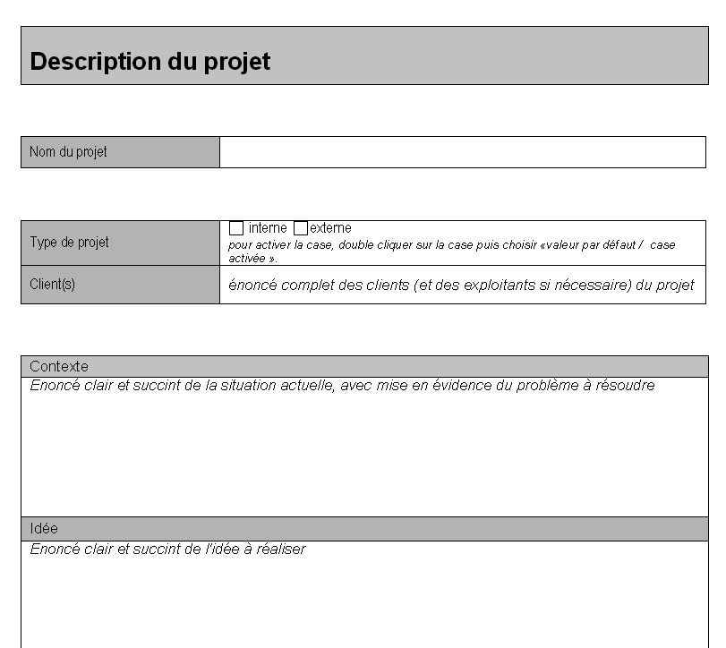
2.2
Project Proposal
Notes:
A document destined for decisionmakers

Slide 27
Contents
Context
Objectives
Macro-planning
Costs
Risks
Success criteria

Slide 28
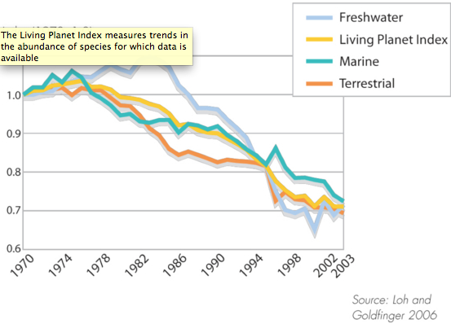
Context
Objective description
  Facts that lead to the project
  No subjective aspects

Slide 29
Objectives: how to diminish the confusion ?
diminish
illiteracy
build a school
improve women
social and professional integration
…
improve our
foundation visibility
…
provide access to education
Notes:
They’re all rigth

Slide 30
Organizing objectives
Overall Objectives
Project's contribution to policy or program objectives
Purposes
Direct benefits to the target group(s)
Results
Tangible products or services delivered by the project
Notes:
deliverable
generate benefits

Slide 31
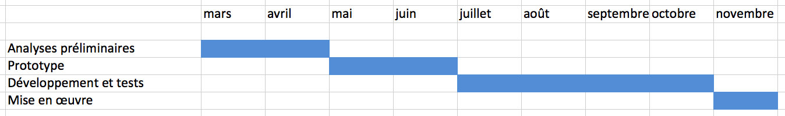
Macro planning

Slide 32
Costs and benefits
Costs
  direct costs and overhead
  human resources
  material
Benefits
  financial
  non financial
Notes:
Non financial benefits: as or even more important for NPO

Slide 33
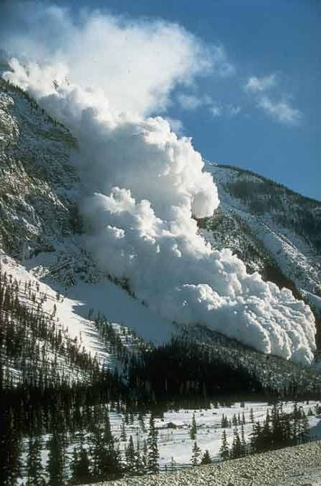
Risks
Risks
  Events that may happen
  If they happen, they may have negative impacts on the project
Risk management
  Identify risks
  Evaluate
    probability and impacts
  Prioritize
    low – high
  Plan risks responses
    avoid – minimize - accept
source : www.sxc.hu
Notes:
treat, consider, deal with

Slide 34
Success criteria
What should be achieved in order to consider the project successful?
Should helps stakeholders to construct a shared view
Measurable
  not subjectives
Questions that may help:
  What does success looks like ?
  How do we know that the project is completed ?
  How will the project manager know if she has done a good job ?
Notes:
Until yet, we have describe "why do we need this project? "
Here: if the project is accepted: …
May be linked to project objectives : ex. diminish illiteracy => of 50%; measured by a test done…

Slide 35
Synthesis
Adapted from the Logical Frame Matrix
Objectives | Success criteria (Indicators & source of verification) | Assumptions
Overall Objectives Project's contribution to policy or program objectives | How participation to OO is to be measured ? | -
Purposes Direct benefits to the target group(s) | How the Purpose is to be measured ? | If the Purpose is achieved, what assumptions must hold true to achieve the OO?
Results Tangible products or services delivered by the project | How the results are to be measured (Quantity, Quality, Time) ? | If Results are achieved, what assumptions must hold true to achieve the Purpose?
Reference: Commission Européenne: Project cycle Management Guidelines
http://ec.europa.eu/europeaid/multimedia/publications/publications/manuals-tools/t101_en.htm

Slide 36
Simulation - initiation
Initiation
Planning
Execution
Closure
Monitor & Control
Objective
  get you project accepted and funded
Deliverable
  Project presentation
  Deadline: _______

Slide 37

Simulation - Initiation
www.AlbaSim.ch

Slide 38
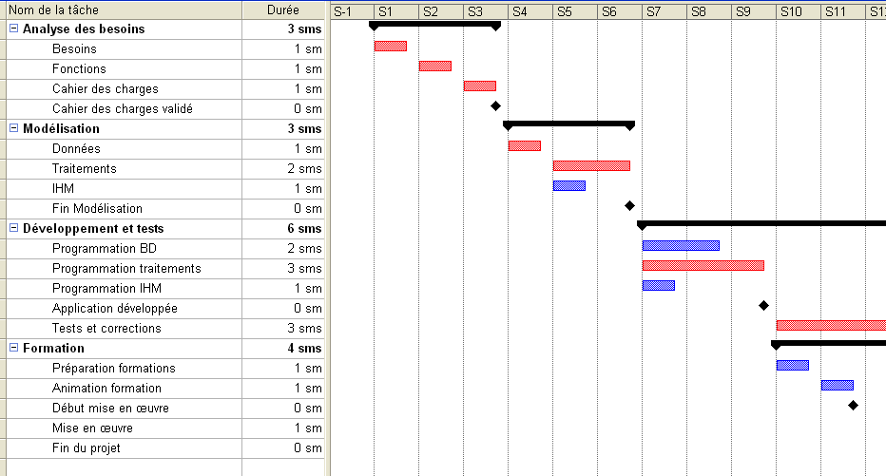
Planning
3
« Do not foresee is already groaning »
Léonard de Vinci [1452-1519]

Slide 39

Work Breakdown Structure (WBS)
Objectives
  identifying all (as much as possible) deliverables and tasks to be done
source : www.sxc.hu

Slide 40
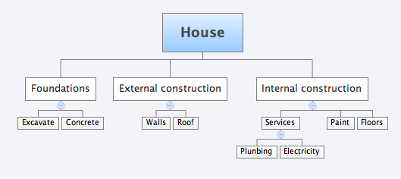
Work Breakdown Structure (WBS)
Hierarchical decomposition
  deliverable oriented (Product Breakdown Structure)
  work to be done (Work Breakdown Structure)
Results and use
  defines total scope
  subdivides the project in more manageable pieces
Notes:
Tasks for Excavate:
Install site
drain
dig

Slide 41

Activity duration estimation
Objective
  estimate time needed for activities identified in WBS
source : www.sxc.hu
Basis for
  project duration estimation
  resources estimation

Slide 42
Network diagram
Objectives
  identifying logical relationships
  identifying tasks that may be executed in parallel
  identifying critical path
Notes:
Ordonnancer et évaluer les actions
Ordonnancer les actions signifie tout d’abord décrire les liens de dépendance chronologique entre elles. Evaluer les actions consiste à estimer le temps nécessaire à leur réalisation ainsi que les dépenses à engager.
_____________________________________________________
_____________________________________________________
_____________________________________________________
_____________________________________________________
_____________________________________________________
_____________________________________________________
_____________________________________________________
_____________________________________________________
_____________________________________________________
_____________________________________________________
_____________________________________________________
_____________________________________________________
_____________________________________________________
_____________________________________________________
_____________________________________________________

Slide 43
Logical Relationships
wake up
breakfast
shower
dress
take the train
  Mandatory links or personnal choices ?
  => represent only mandatory links

Slide 44

Network diagram ?
Walls
duration: 3
Excavate
duration: 2
Roof
duration: 3
Paint
duration: 1
Concrete
duration: 2
Floors
duration: 1
source : www.sxc.hu
Plumbing
duration: 2
Electricity
duration: 1
Notes:
Slack time (or float): amount of delay that could be tolerated on a task without cuasing a delay in the completion of the project.
Critical path:
the longest path trough the network
the minimal duration of the the project (if enough resources)

Slide 45
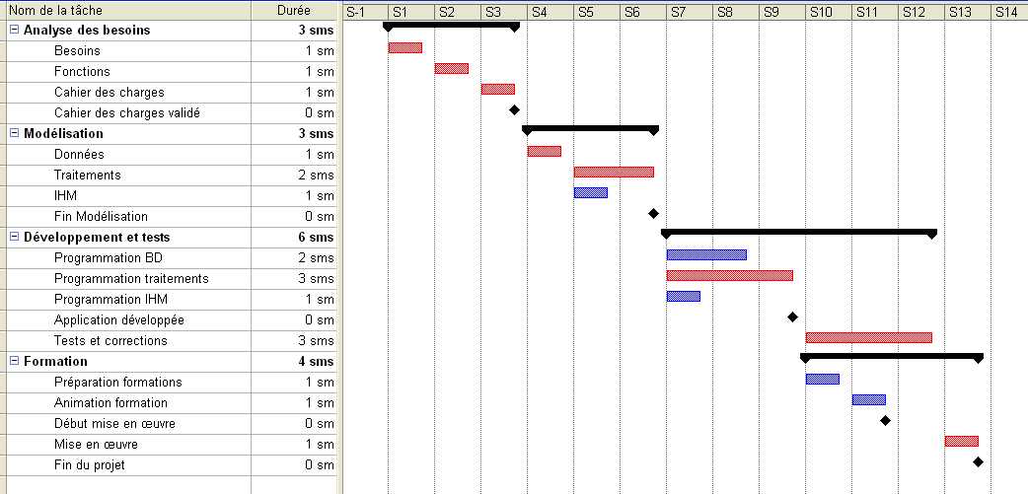
Gantt Chart
Notes:
show how the project si supposed to progress

Slide 46

Milestones
A moment in time
  where something started or finished
A major occurrence
  completion of several activites
  major approval
    Not an activity (process of doing something, consume time)
source : gribouille24

Slide 47
Resources Allocation
Type | Name | Costs | Tasks
Electrician | Philip | 7000 | Electricity
Electrician | Maria | 7200 | Electricity
Builder | Marc | 6500 | Excavate, foundations
…

Slide 48
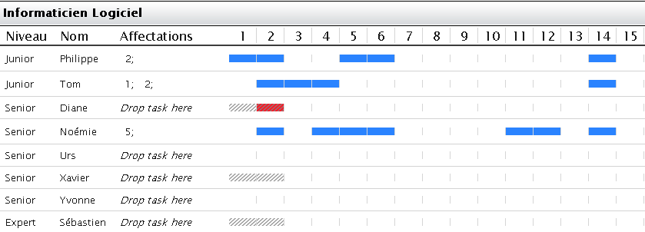

Resources Gantt Chart

Slide 49

Planning Optimization
Objective:
Find the best scenario
source : www.sxc.hu
Constraints
  Time
  Cost
  Resources
  Network diagram

Slide 50
Simulation - Planning
Initiation
Planning
Execution
Closure
Monitor & Control
Objective
  plan the project
  get your planning validated
Delivrable
  In the software: Gantt, BAC, Resources for first weeks
  Presentations: activities diagram, Gantt, detailed budget, comments
Deadline:
Notes:
strategy: how did you approach, tackle the problem, how did you solve it

Slide 51
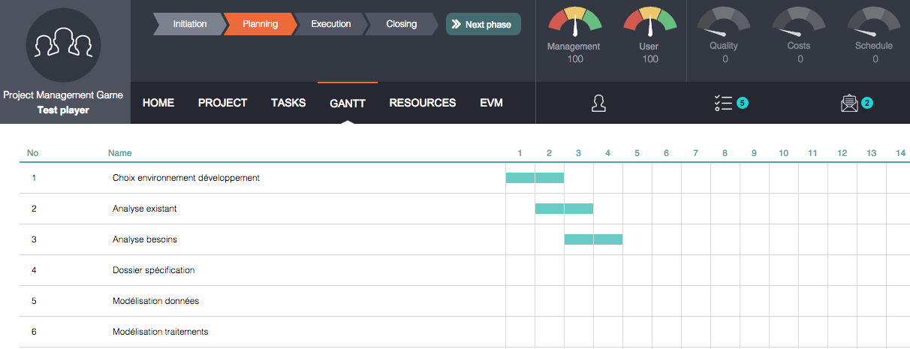
Simulation - Planning
www.AlbaSim.ch

Slide 52
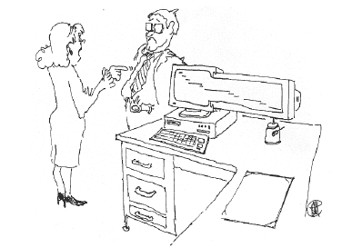
Project execution
4
« We have developed those special screens when we realized the problems of delay »
Notes:
What is the role of the project manager during execution ?
be aware of problems, differences between planning and execution
undertake action to correct problems
Anchor biasbbnnb

Slide 53

Monitor & Control
Monitor
  decision support level
  data collection
  information reporting
    should enable to identify problems
Control
  decision level
  based on monitoring information and reports
  corrective actions
source : www.sxc.hu

Slide 54
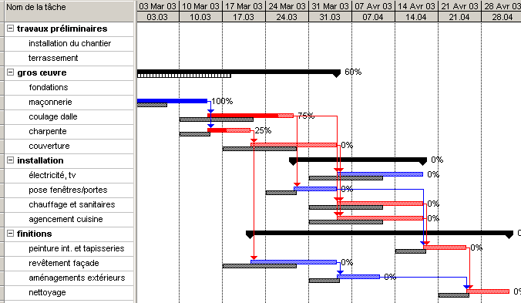
Tracking Gantt Chart
Notes:
Advantages: easy to understand
Disadvantages: may be long to keep up to date, too much information for big projects

Slide 55
Milestones trend chart
Planning
End
july
june
may
april
march
february
january
Time
january
february
march
april
may
june
july
Notes:
Idea: focuse on important moment in the project
First version: one milestone: “end of the project”.

Slide 56
Milestones trend chart
Planning
End
july
june
may
Milestone 2
april
march
Milestone 1
february
january
Time
january
february
march
april
may
june
july
Notes:
Advantages:
synthesis
trend
not too much details
Disadvantages:
we do not know from where the problem comes (well…)
10’ to learn

Slide 57
Results orientation
Goals and results directed
Empower team members
  Each deliverable has a responsible
  Regular update of the deliverable indicator
  (green/orange/red)
Notes:
Advantages
motivation
simple
proactive
integrate objectives, costs and schedule
dynamic
non administrtive work
Disadvantages:
what is green, orange, red ?
possible to cheat

Slide 58
Project modifications management
Difficult (impossible) exactly define all fonctionnalities
Project management is a dynamic process
Oh, just add…
Better to be prepared to deal with change requests
Notes:
Modifications management
Not the changes induce by the project in the organization or for stakeholders.

Slide 59
Change procedure
Change request
Consequences assesment
Choice
Change accepted
Change refused

Slide 60
Form for change management
Project name:__________ Applicant: __________ Date: ______
Request description and justification:
Assesment of consequences: - cost - time - risks PM signature:
Customer decision: accept / refuse Customer signature:

Slide 61
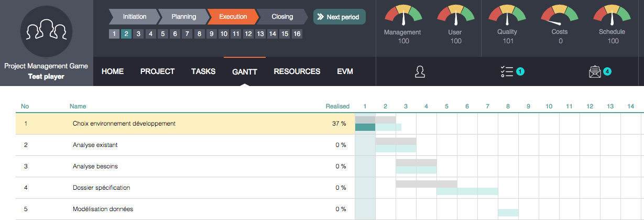
Simulation - Execution
www.AlbaSim.ch

Slide 62
Simulation - Execution
Initiation
Planning
Execution
Closure
Monitor & Control
Objectives
  realize the project
Deliverables
  project finished
  Steering Comitee presentation
  Lessons learned
Deadlines: _________

Slide 63
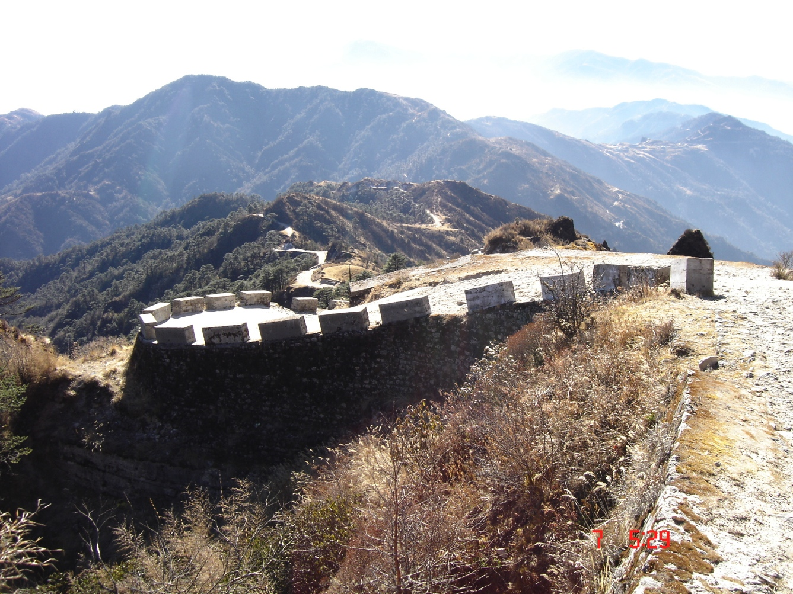
Thanks for your attention !

